Slide 1
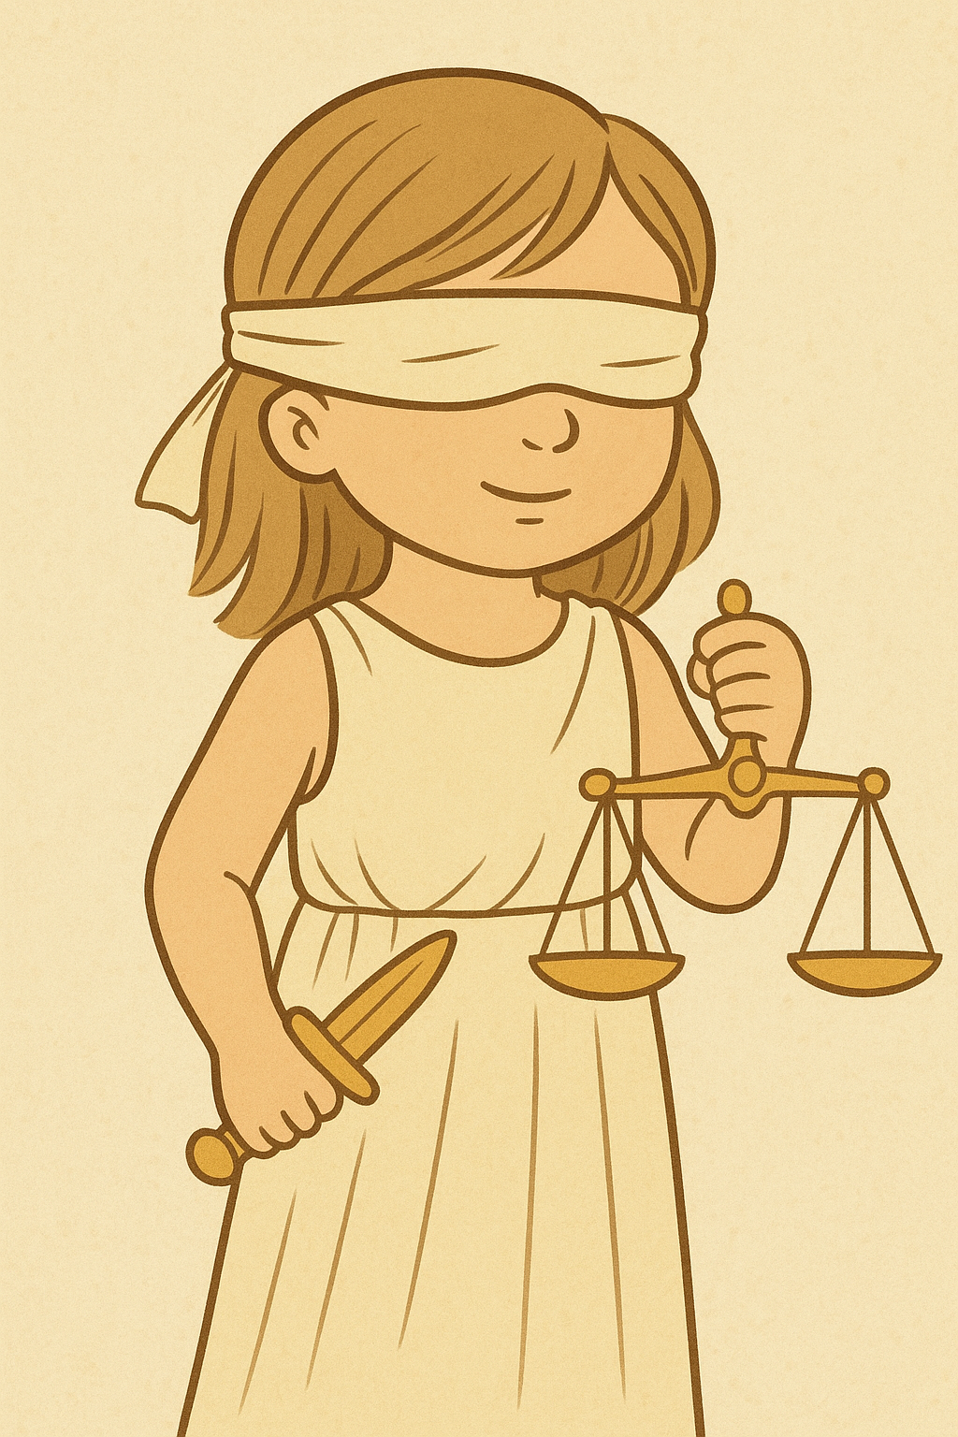

Law’s Little Users
Ivar Rodríguez Hannikainen
ivar@ugr.es
moralsciencelab.com

Slide 2
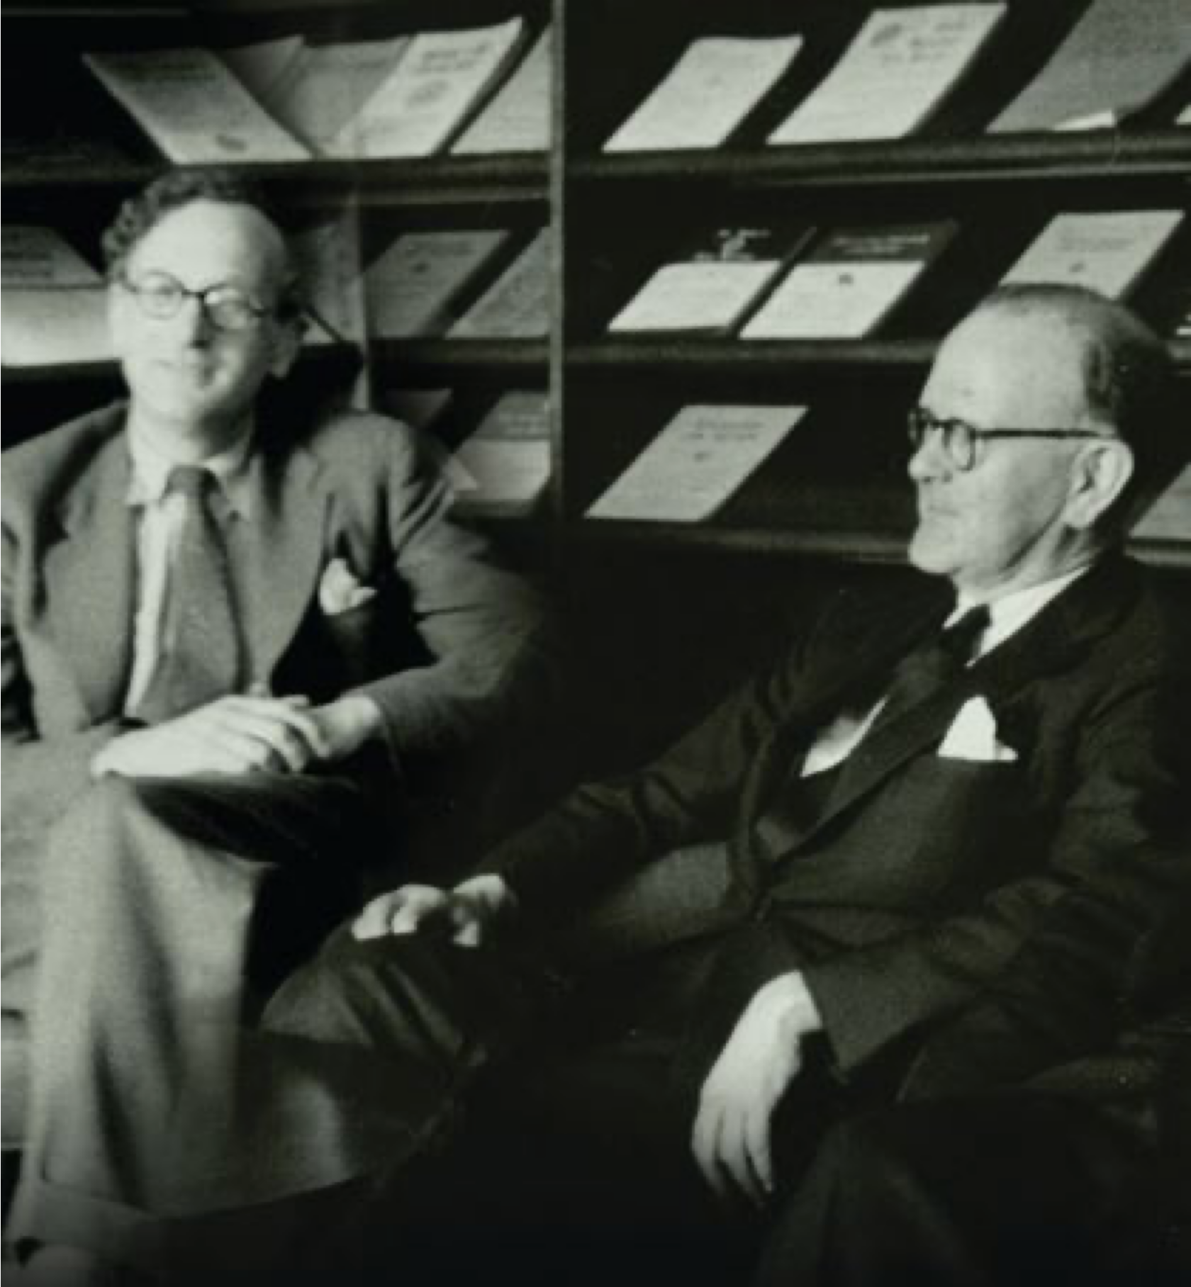
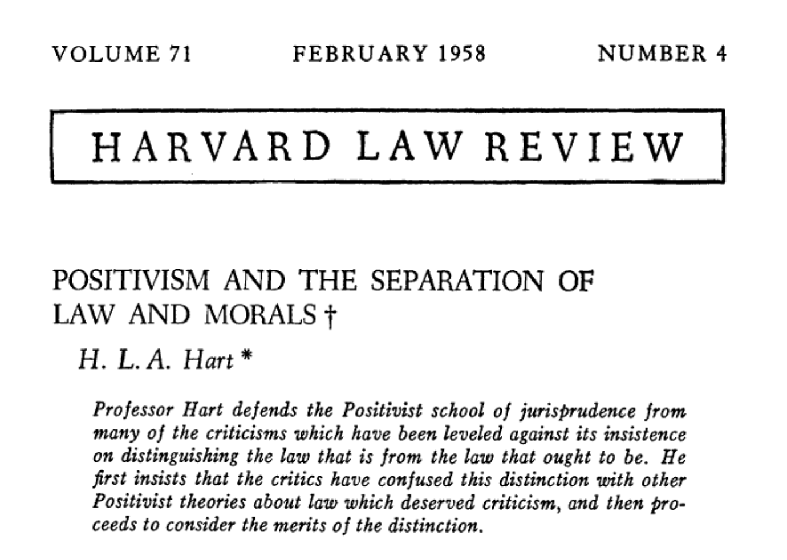

Slide 3
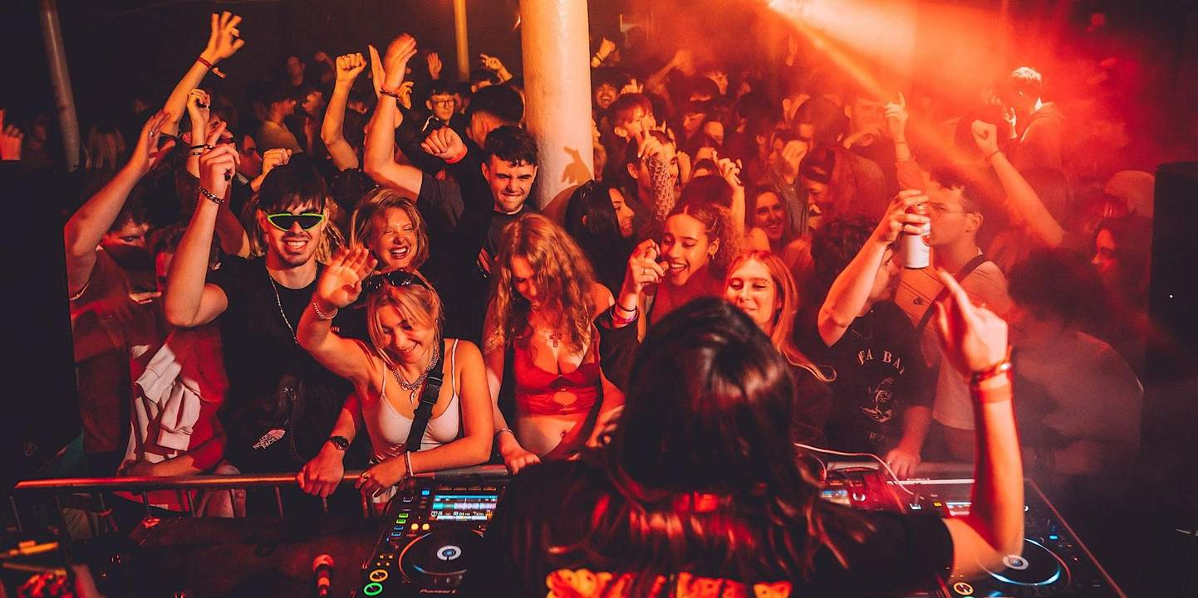

Slide 4


NO MUSIC
PAST 10PM

Slide 5
no music past 10 in order to allow rest

Slide 6
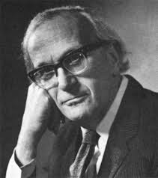
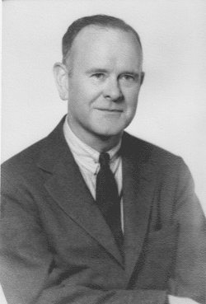
no music past 10 in order to allow rest
textualism
purposivism

Slide 7
NO MUSIC
PAST 10PM

Slide 8
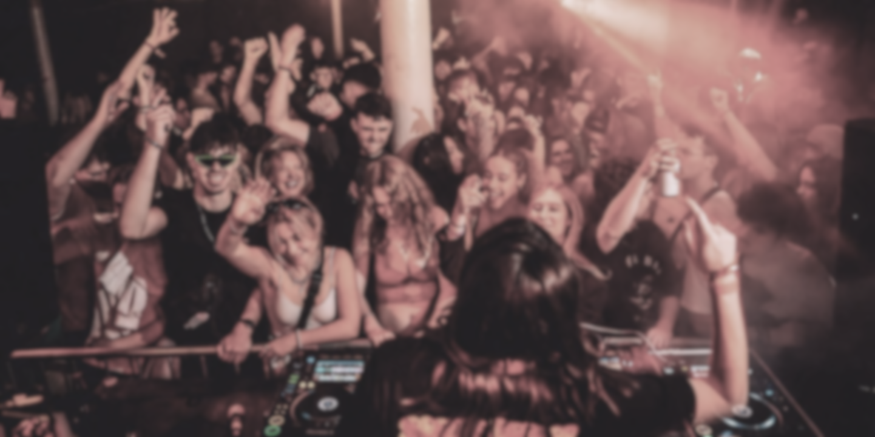
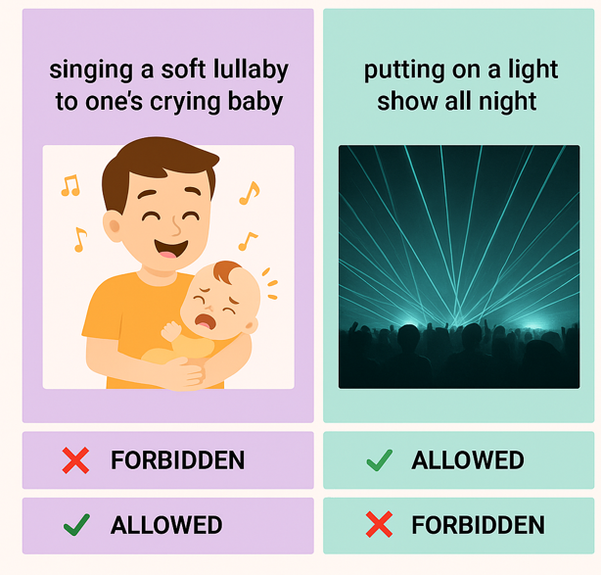
Which behaviors are against the rule?
Humming a lullaby to one’s crying baby at 1AM
NO MUSIC
PAST 10PM
Textualist verdict:
Purposivist verdict:

Slide 9

Which behaviors are against the rule?
Humming a lullaby to one’s crying baby at 1AM
NO MUSIC
PAST 10PM
Literalist, ‘plain meaning’ textualist
Textualist verdict:
Purposivist verdict:
Pragmatist, intentionalist, moralist

Slide 10


Which behaviors are against the rule?
Humming a lullaby to one’s crying baby at 1AM
NO MUSIC
PAST 10PM
Textualist verdict: | FORBIDDEN
Purposivist verdict: | ALLOWED

Slide 11
Which behaviors are against the rule?
Humming a lullaby to one’s crying baby at 1AM | Putting on a late-night light show
NO MUSIC
PAST 10PM
Textualist verdict: | FORBIDDEN |  | ALLOWED
Purposivist verdict: | ALLOWED |  | FORBIDDEN

Slide 12
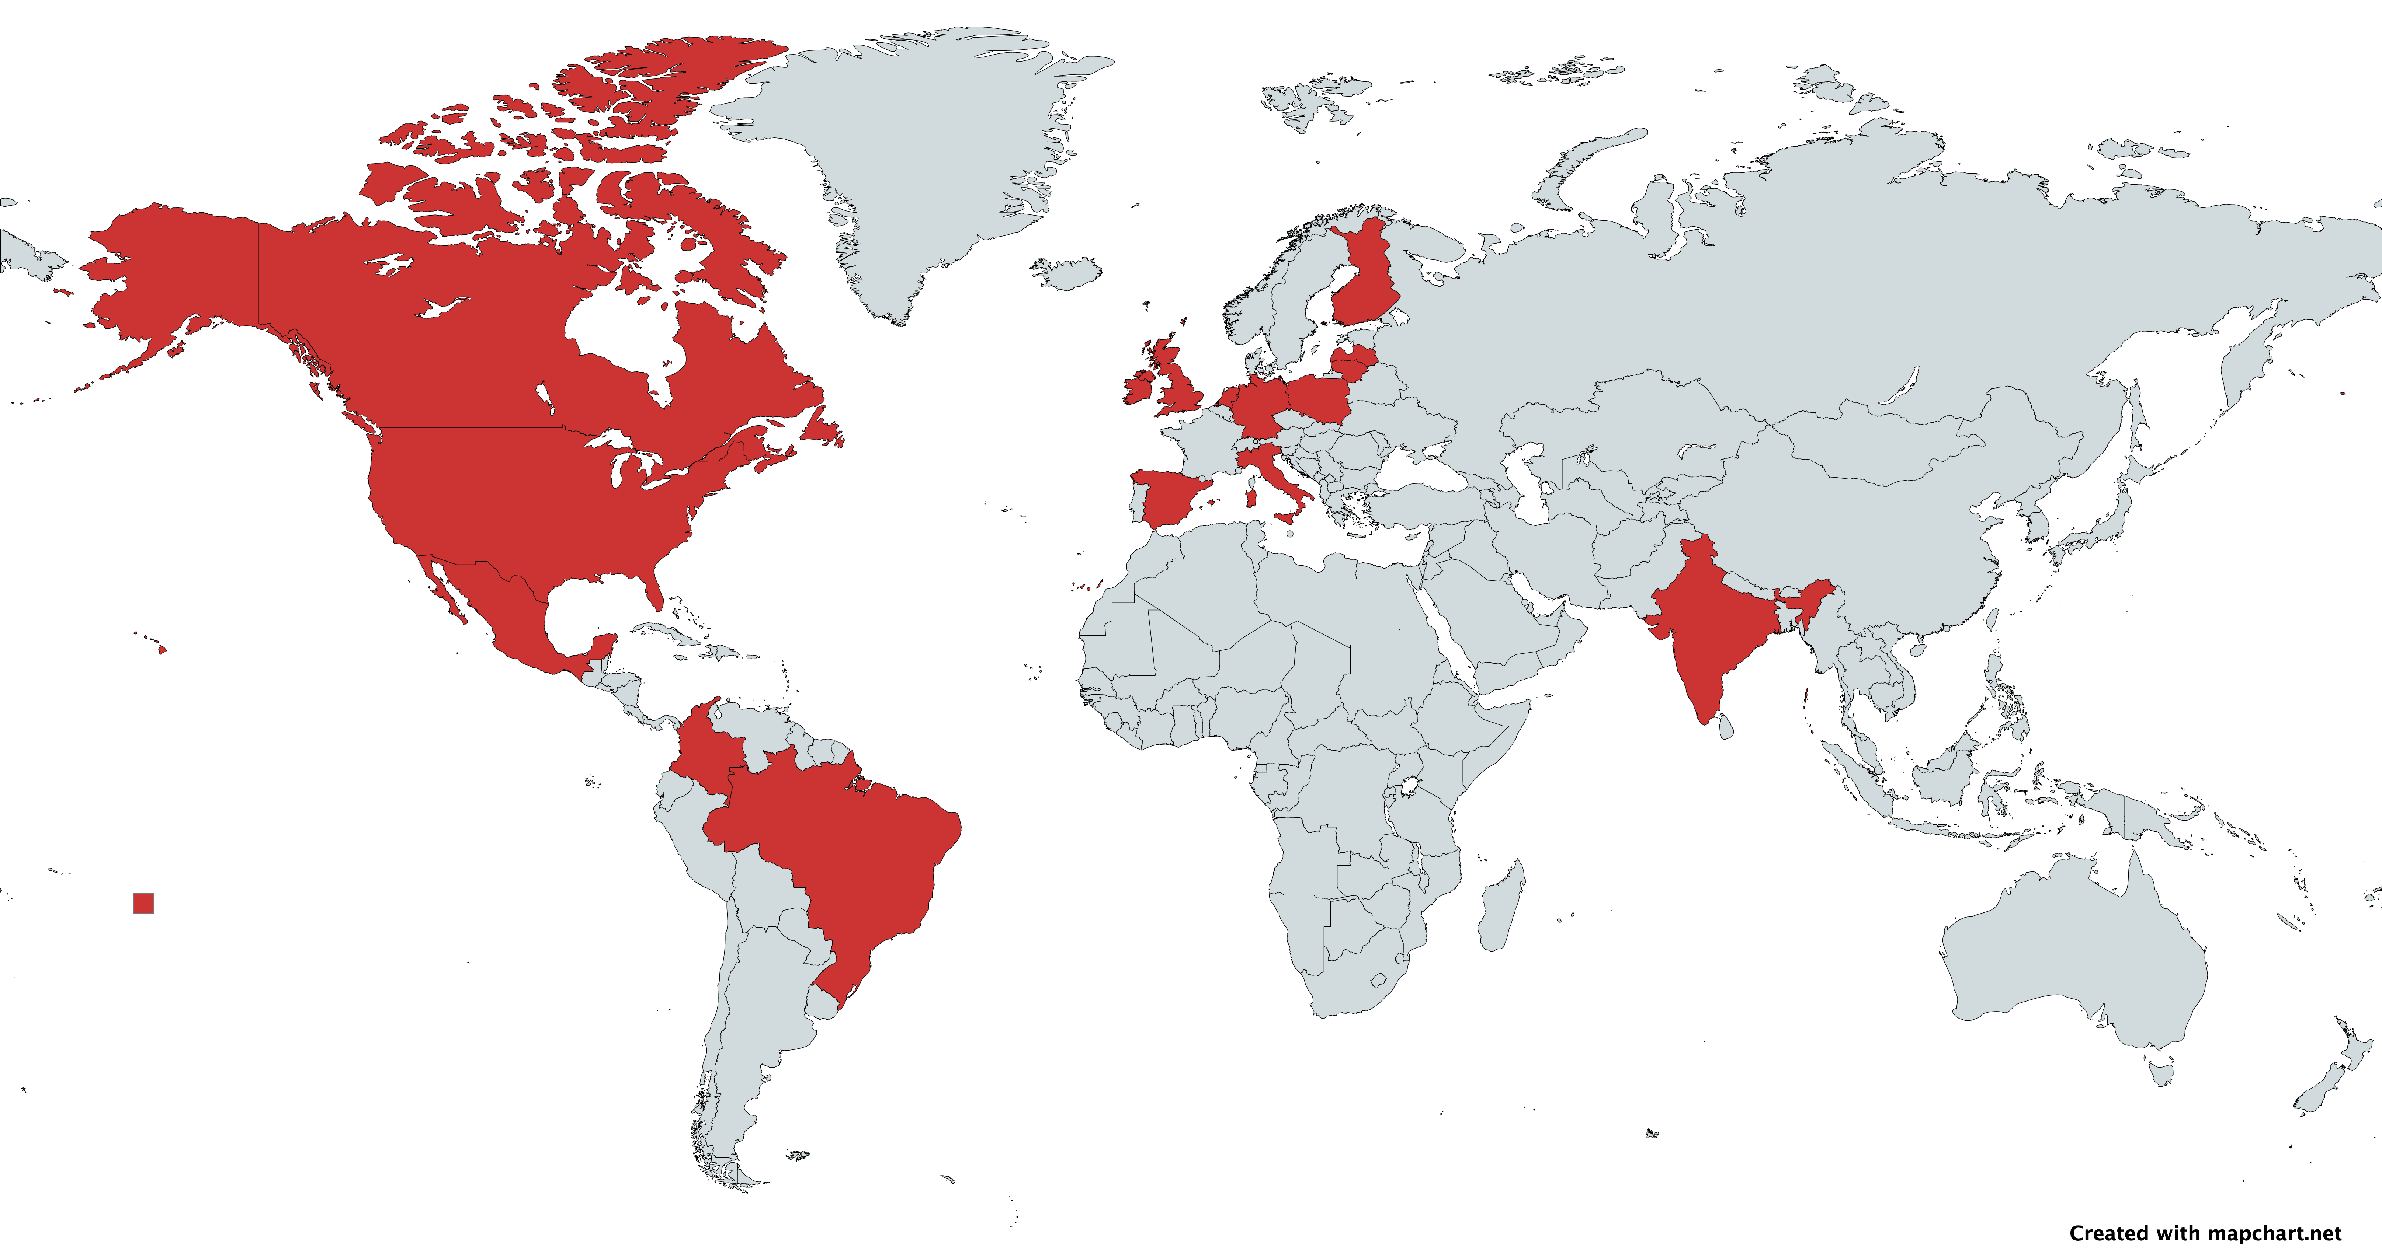
k = 15
N = 4895

Slide 13
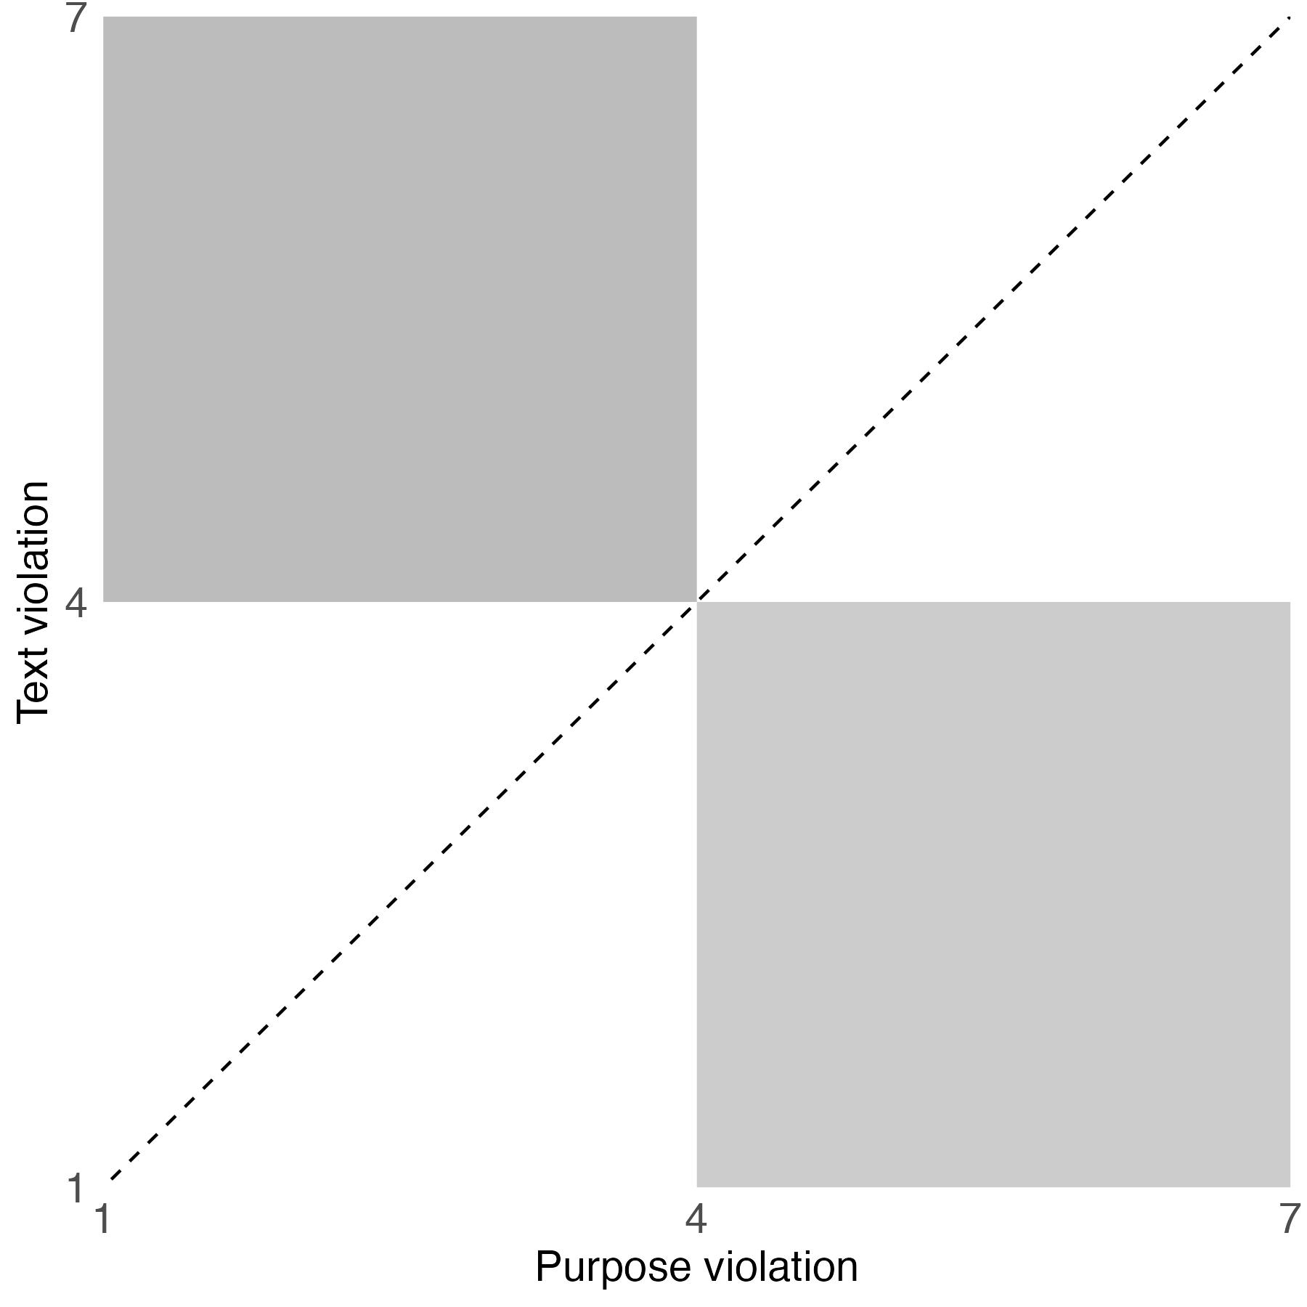
FORBIDDEN
ALLOWED
ALLOWED
FORBIDDEN

Slide 14
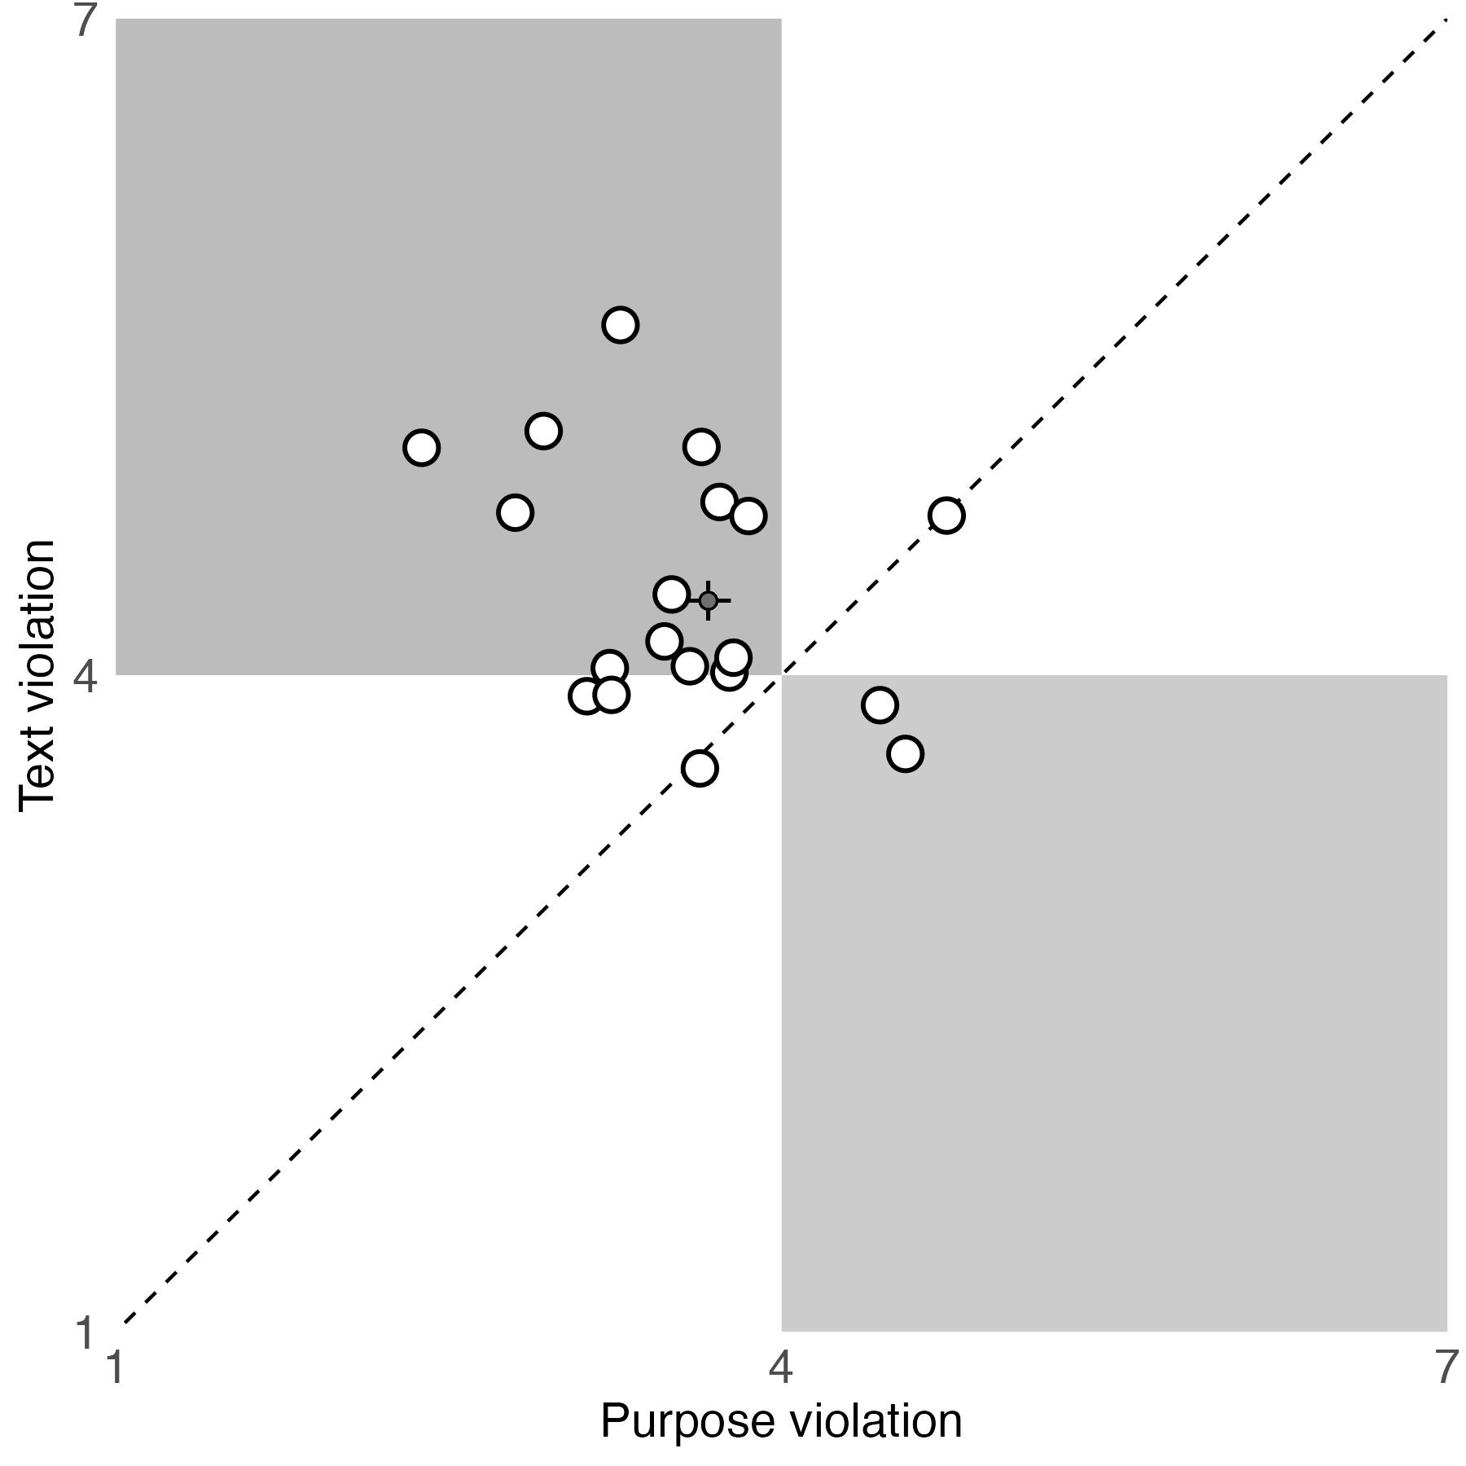
FORBIDDEN
ALLOWED
ALLOWED
FORBIDDEN
Hannikainen et al., 2022 PNAS

Slide 15
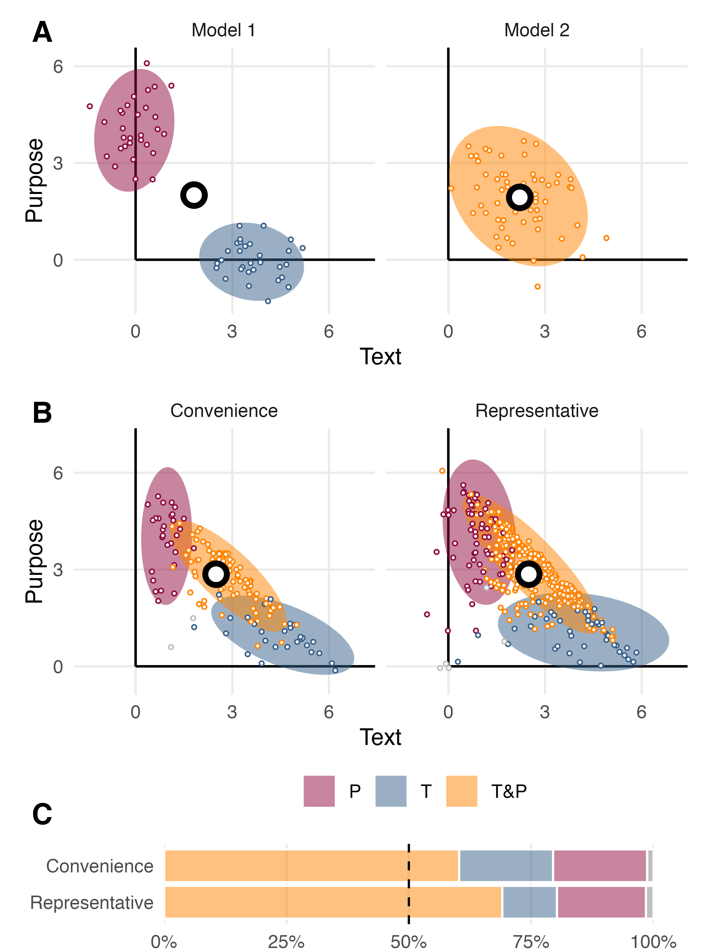
People are torn between letter and spirit.
👥 Disagreement 👤 Conflict
Almeida et al., 2025, J Res Pers

Slide 16
People are torn between letter and spirit.
👥 Disagreement 👤 Conflict
60% - 69% fit 👤 conflict
40% - 31% fit 👥 disagreement
Almeida et al., 2025, J Res Pers

Slide 17
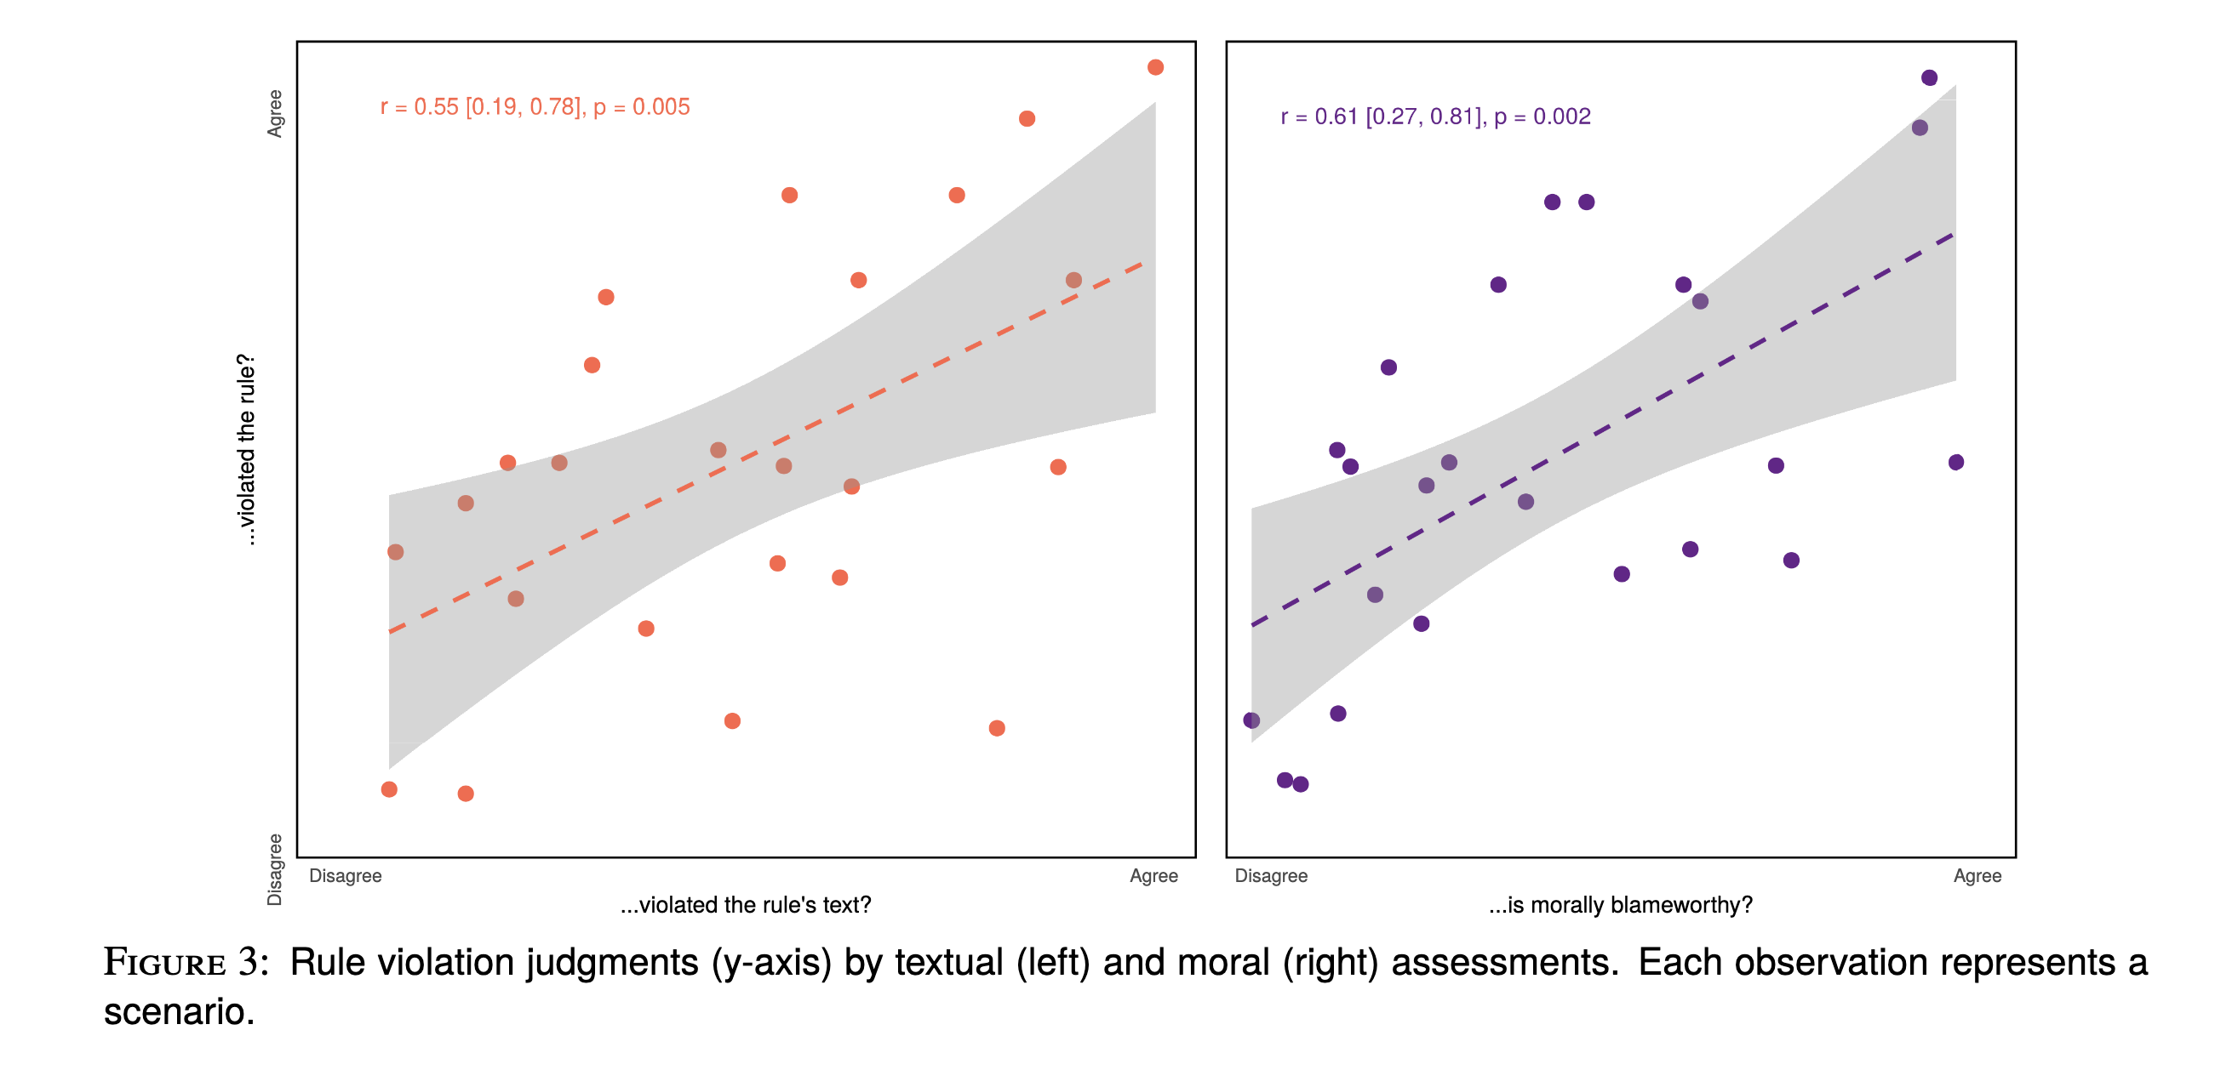
Concerns about purpose reflect moral condemnation.
Struchiner et al., 2020, JDM

Slide 18
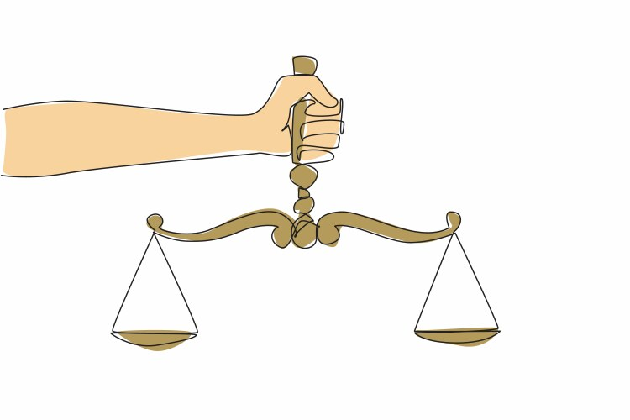
Background
Adults balance letter and spirit. (discretion).
This reflects conflict between enforcing a rule’s plain text and competing moral considerations.

Slide 19
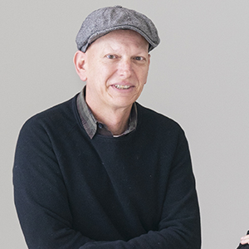
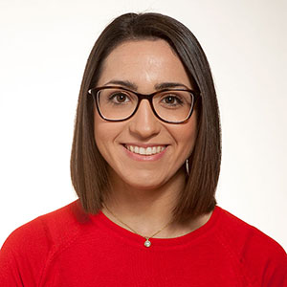

Agustín Vicente
Marta Ponciano

Slide 20
Agustín Vicente
Marta Ponciano
How does this capacity for rule interpretation and discretion develop throughout childhood?

Slide 21
1. Rule presentation

Slide 22
2. Control cases

Slide 23
3. Conflict cases
Jane

Slide 24
6 rules x 4 cases = 24 judgments per participant
2 letter (violate, comply) x 2 purpose (violate, comply)

Slide 25
49 children | 51 young adults | 51 older adults
5 to 8 years old | 18 to 25 years old | 45 to 65 years old
verbally administered | self-administered
on school premises | online

Slide 26
Predictions
Letter-as-precursor hypothesis
First…
children rigidly apply the rules’ letter.
Later…
they acquire an appreciation for the rule’s spirit with age.
glmer(violation ~ (text + purpose) * age_group) + …, …

Slide 27
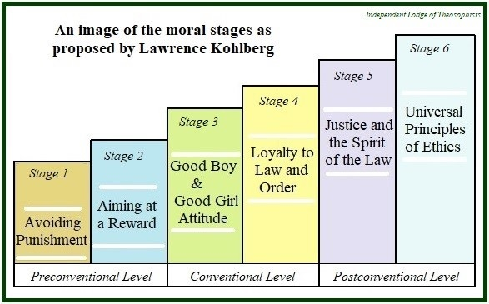
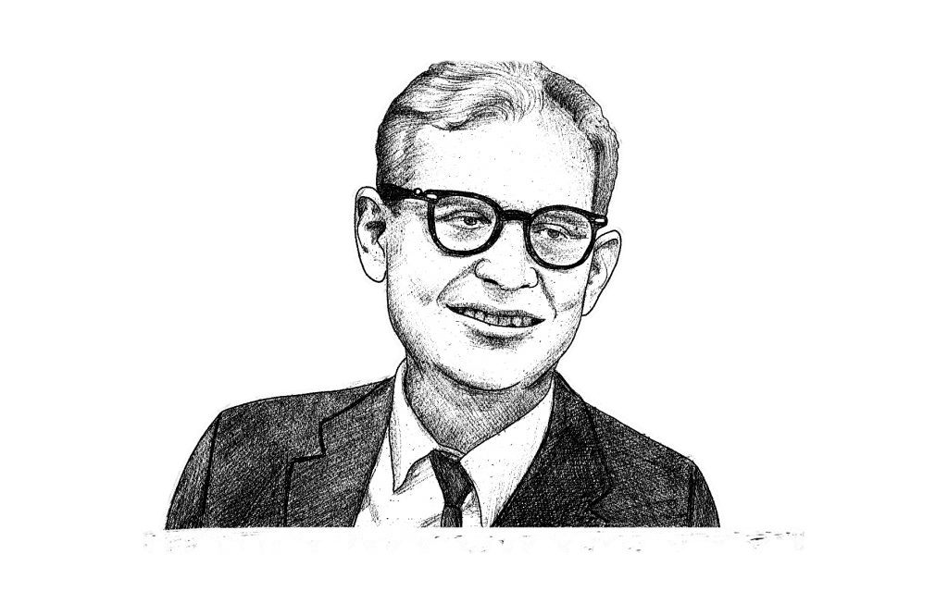
Predictions
Letter-as-precursor hypothesis
First…
children rigidly apply the rules’ letter.
Later…
they acquire an appreciation for the rule’s spirit with age.

Slide 28
Predictions
Spirit-as-precursor hypothesis
First…
children prioritize the rules’ spirit.
Later…
they acquire an appreciation for the rule’s letter with age.
glmer(violation ~ (text + purpose) * age_group) + …, …

Slide 29
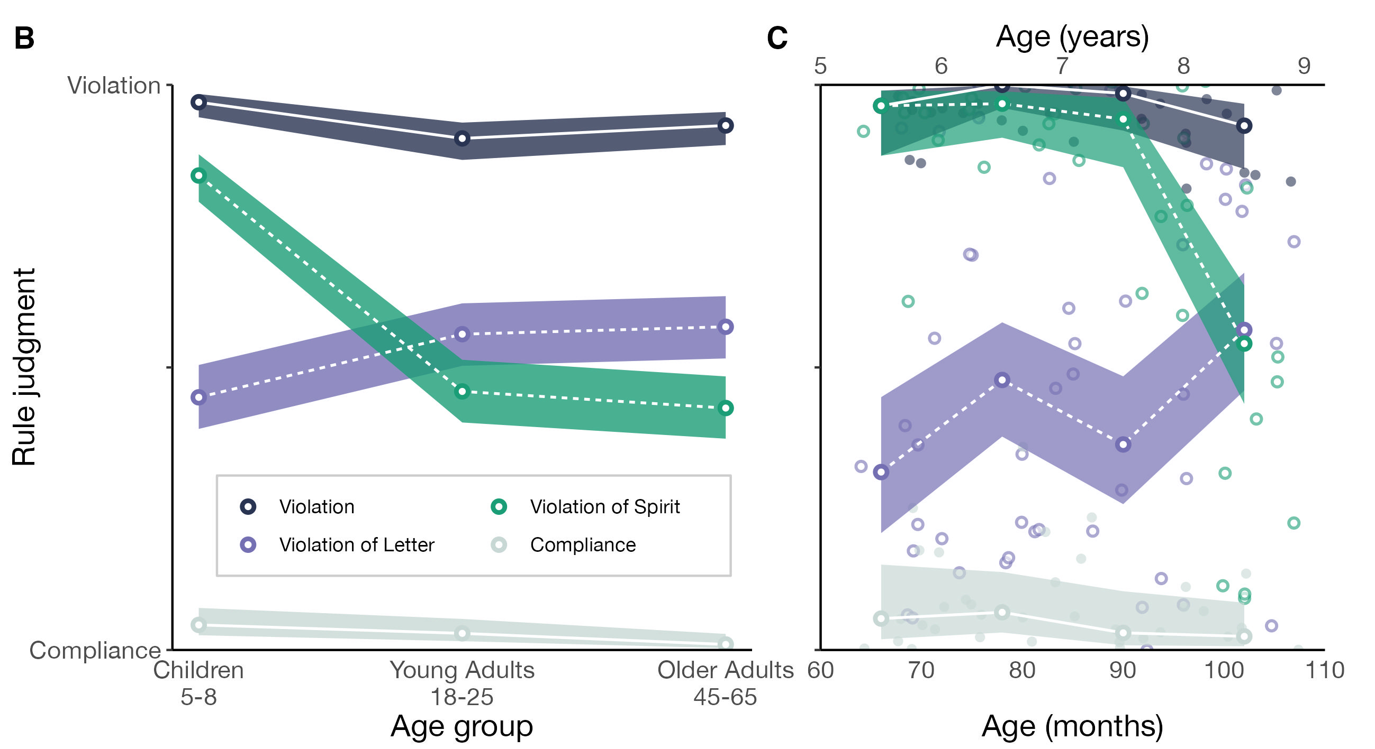

Slide 31
text * age_group: χ² = 17.11, p < .001
purpose * age_group: χ² = 28.45, p < .001

Slide 34
Why?

Slide 35
Literal and moral appraisals (N = 51)

Slide 36
Literal and moral appraisals (N = 51)

Slide 37
Literal and moral appraisals (N = 51)

Slide 38
Literal and moral appraisals (N = 51)

Slide 39
Literal and moral appraisals (N = 51)

Slide 40
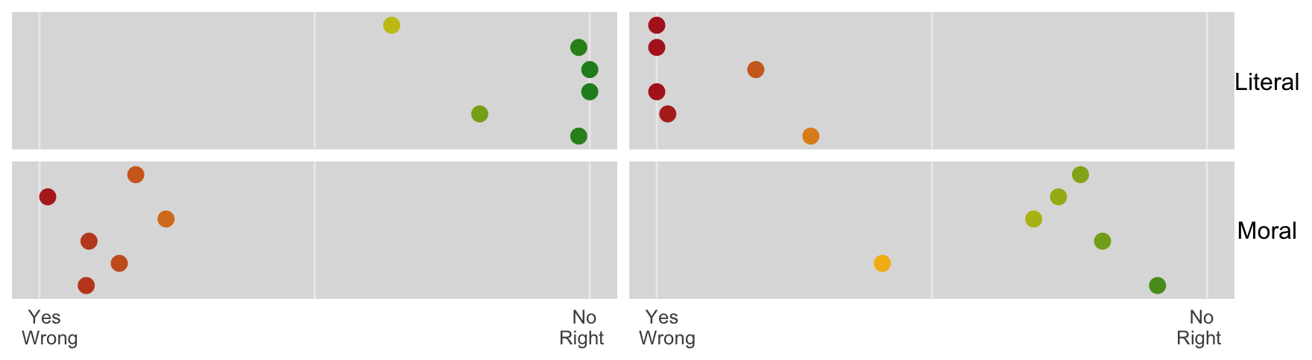
Literal and moral appraisals (N = 51)

Slide 41
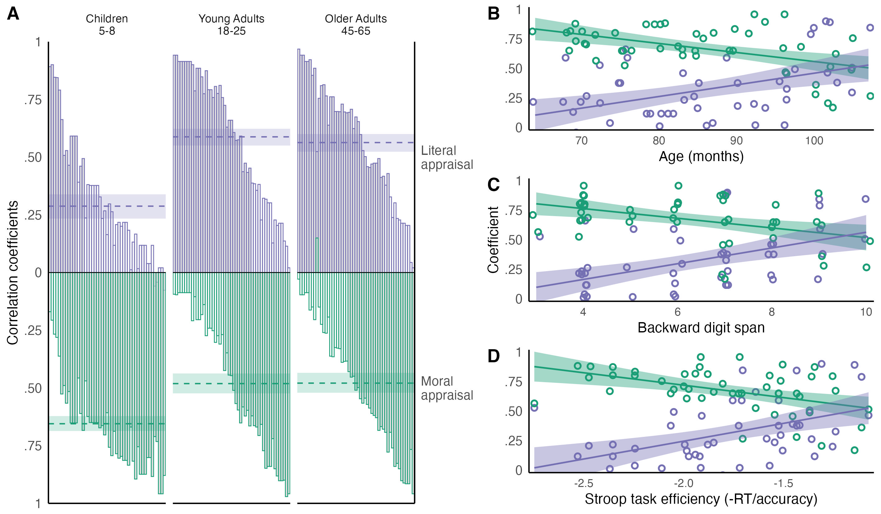
How well do literal and moral appraisals (item averages) predict children and adult’s rule violation judgments?

Slide 42
How well do literal and moral appraisals (item averages) predict children and adult’s rule violation judgments?

Slide 45

Letter-as-precursor hypothesis
First…
children prioritize the rules’ spirit.
Later…
they acquire an appreciation for the rule’s letter with age.
But really why?
Spirit-as-precursor hypothesis
First…
children prioritize the rules’ spirit.
Later…
they acquire an appreciation for the rule’s letter with age.

Slide 47
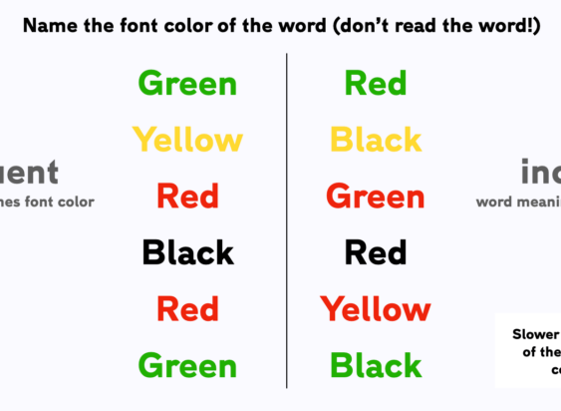
Accuracy: correctly name the animal based on its body.
Reaction time (RT; ms): the delay from onset of stimulus.

Slide 48
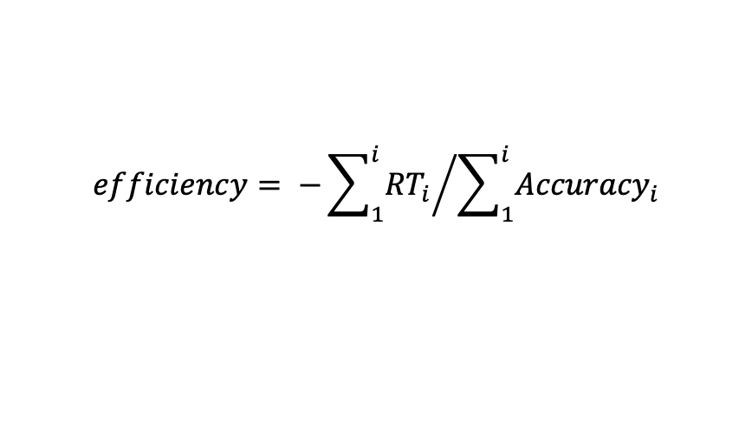
$$efficiency= {−\sum_{1}^{i}{{RT}_{i}}}/{\sum_{1}^{i}{{Accuracy}_{i}}}$$
Accuracy: correctly name the animal based on its body.
Reaction time (RT; ms): the delay from onset of stimulus.
Liesefeld & Janczyk, 2019, Behav Res Methods

Slide 49

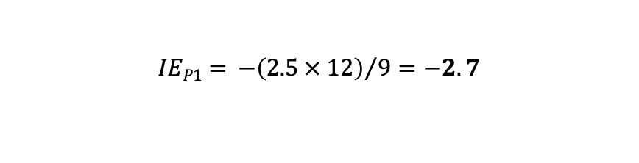
$$efficiency= {−\sum_{1}^{i}{{RT}_{i}}}/{\sum_{1}^{i}{{Accuracy}_{i}}}$$
Accuracy: correctly name the animal based on its body.
Reaction time (RT; ms): the delay from onset of stimulus.
Participant 1 takes 2s per answer and gives 9 correct answers:
Conceptually…
the average cost in seconds to
provide a correct answer.
$$IEP1= {−\left(2.5 × 12\right)}/9=−2.7$$
Participant 2 takes 1.3s per answer and gives 11 correct answers:
$$IEP2={−\left(1.3 × 12\right)}/{11}=−1.4$$
Liesefeld & Janczyk, 2019, Behav Res Methods

Slide 50
Literal appraisal
Moral appraisal

Slide 51


Literal appraisal
Moral appraisal
Participant 1
Participant 2

Slide 52
Literal appraisal
Moral appraisal

Slide 54
Controlling for age in months:
partial-ρ = .39, p = .007
p = .090 (n.s.)
ρ = -.43, p = .002
ρ = .53, p < .001

Slide 55
Recap
1. Adults balance letter and spirit. We are conflicted between enforcing a rule’s plain text and competing moral considerations.

Slide 56
Recap
1. Adults balance letter and spirit. We are conflicted between enforcing a rule’s plain text and competing moral considerations.
2. Children do NOT. They care very little about the rule’s plain text.

Slide 57
Recap
3. Their application of rules tracks adults’ moral judgments very closely.
1. Adults balance letter and spirit. We are conflicted between enforcing a rule’s plain text and competing moral considerations.
2. Children do NOT. They care very little about the rule’s plain text.

Slide 58
Recap
3. Their application of rules tracks adults’ moral judgments very closely.
1. Adults balance letter and spirit. We are conflicted between enforcing a rule’s plain text and competing moral considerations.
2. Children do NOT. They care very little about the rule’s plain text.
4. Cognitive development and, in particular, inhibitory control seems to support the acquisition of textualist intuitions.

Slide 59
Traces of an intuitive commitment to natural law?

Slide 60
Traces of an intuitive commitment to natural law?

Slide 61
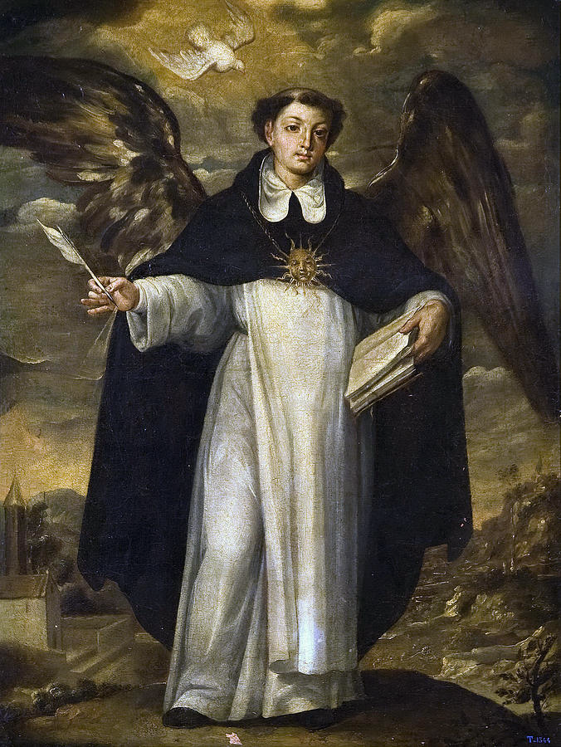
Traces of an intuitive commitment to natural law?

Slide 62
Thank you!
Ivar Rodríguez Hannikainen
ivar@ugr.es
moralsciencelab.com

Slide 64
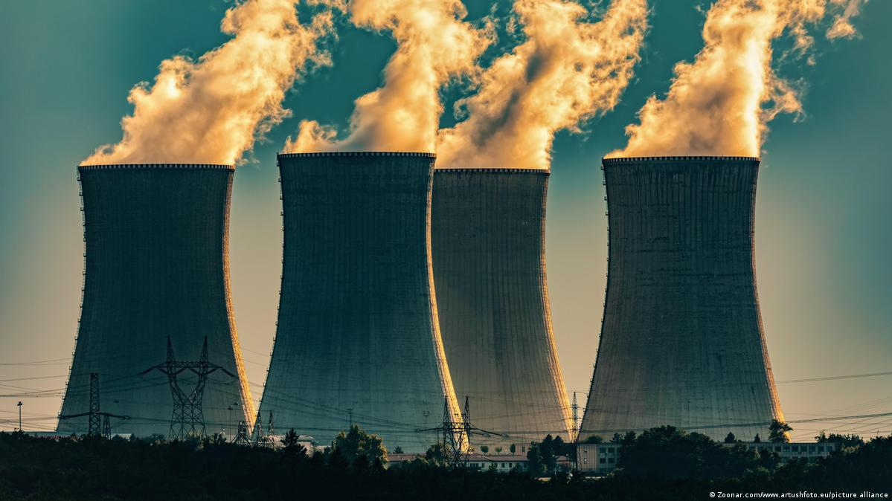

Slide 65

At the nuclear power plant, scientists experiment with sources of clean energy.
To ensure the staff’s safety, the director creates the rule.
A tech hobbyist gains access and plays with the equipment.
At the nuclear power plant, evil scientists experiment with human exposure to radiation.
To keep the project secret, the director creates the rule.
A journalist gains access and exposes the humanitarian crimes.

Slide 66
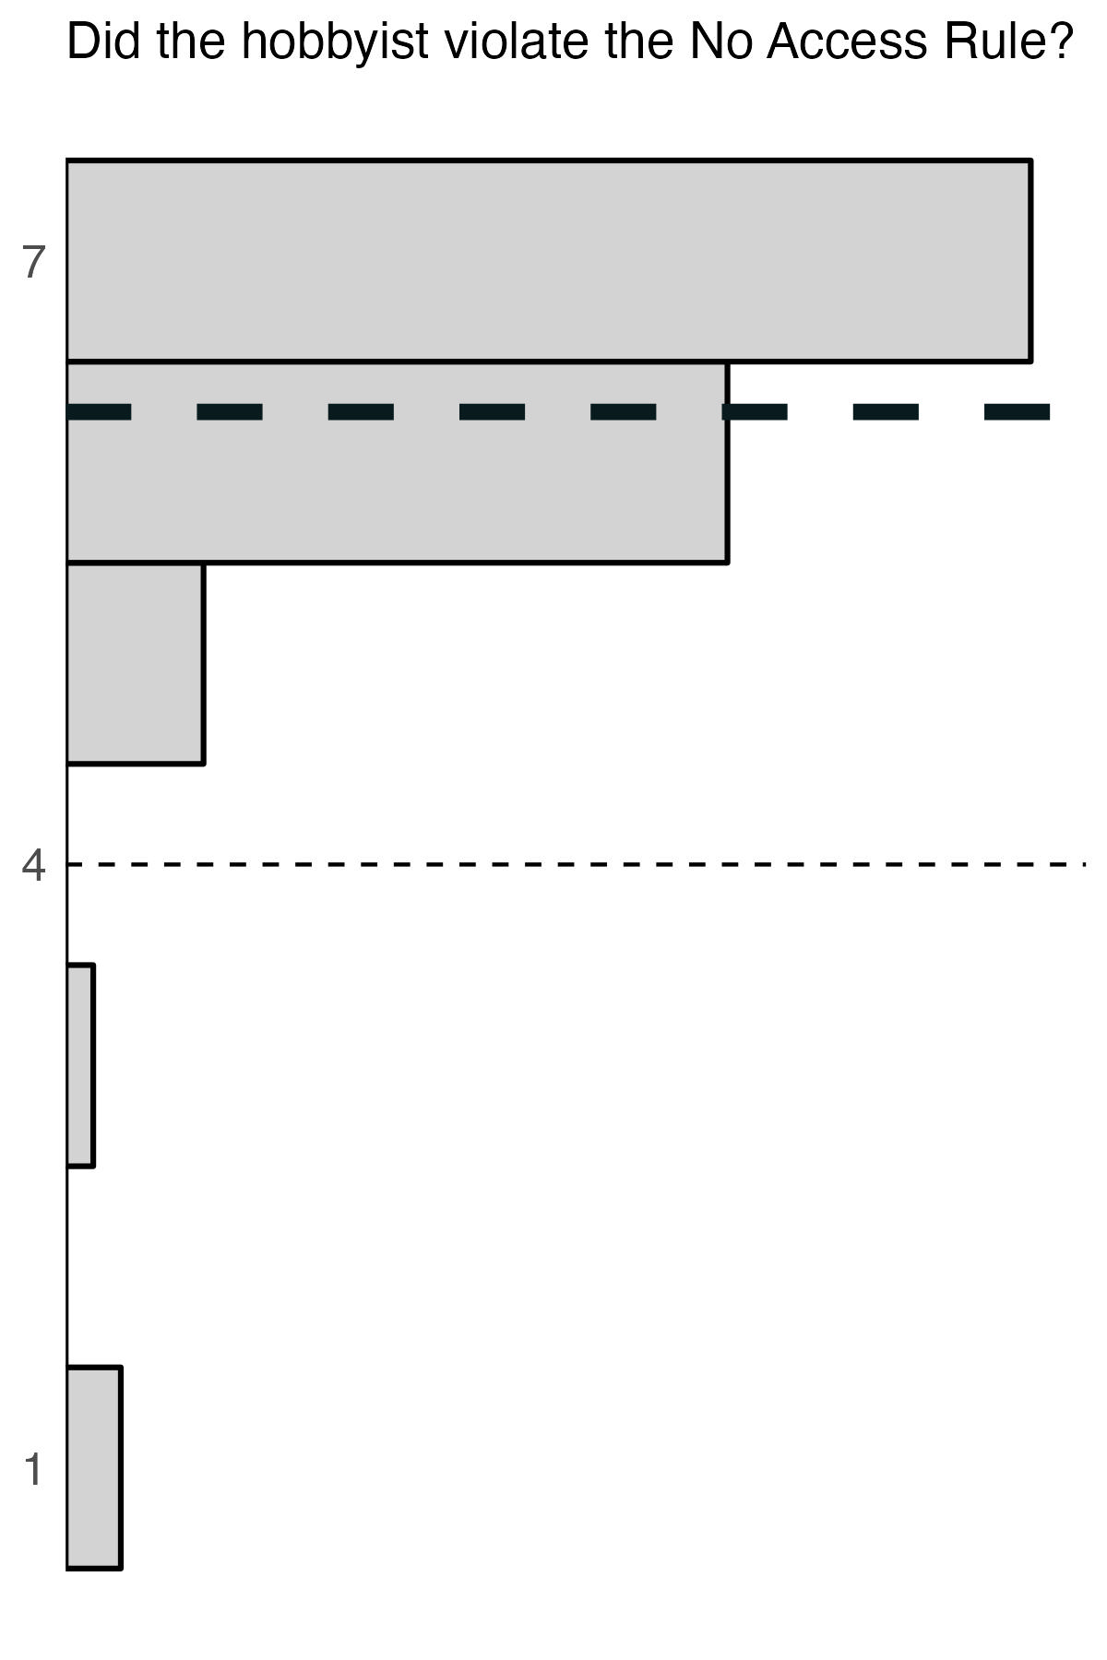
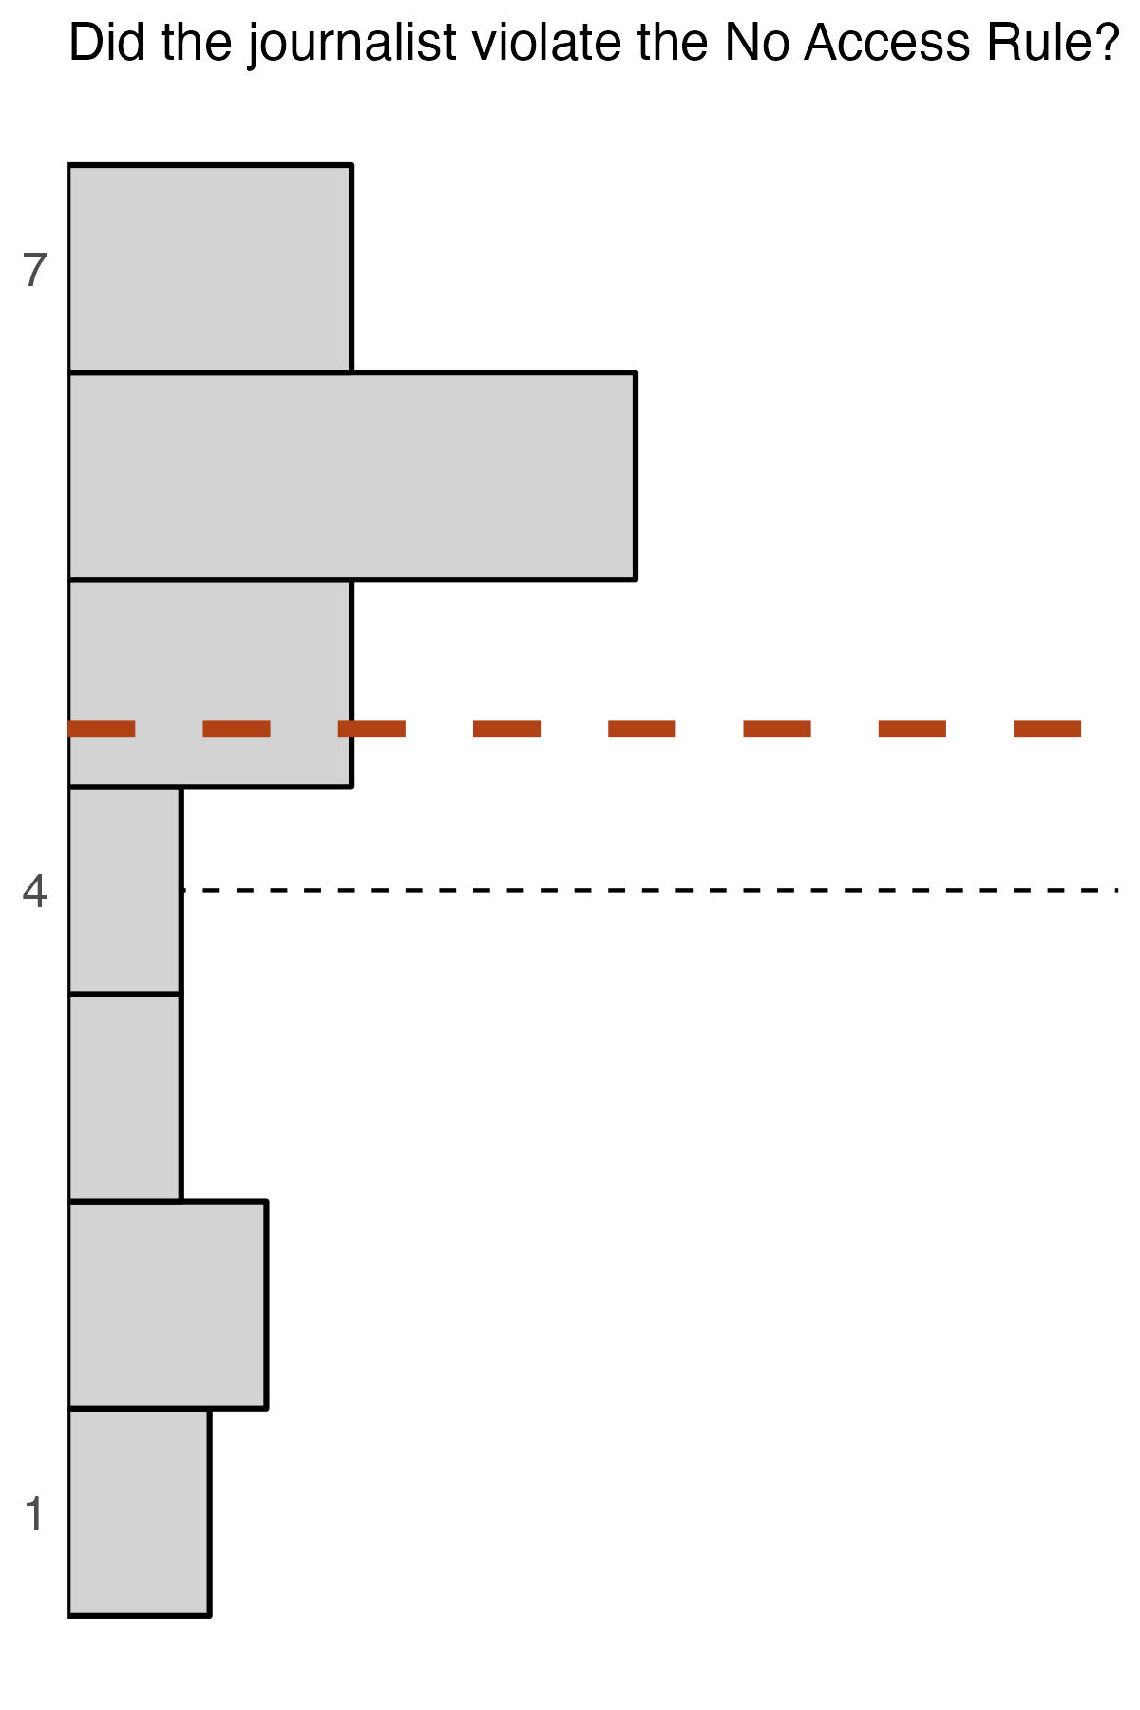
Histograms
6.23 vs. 491
Flanagan et al., 2023, Law & Hum Behav.

Slide 68
A fervent supporter visits the lab to applaud the scientists’ work.
A lab technician leaks footage of the scientists’ cruel acts.
A retired scientist returns to the lab to empty her desk.
A sleepy lab technician handles the equipment carelessly.

Slide 69
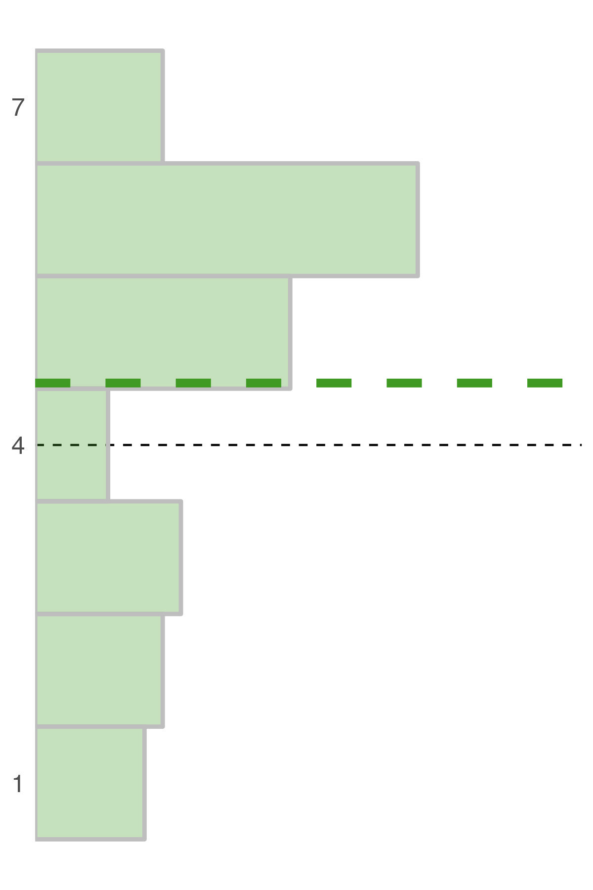
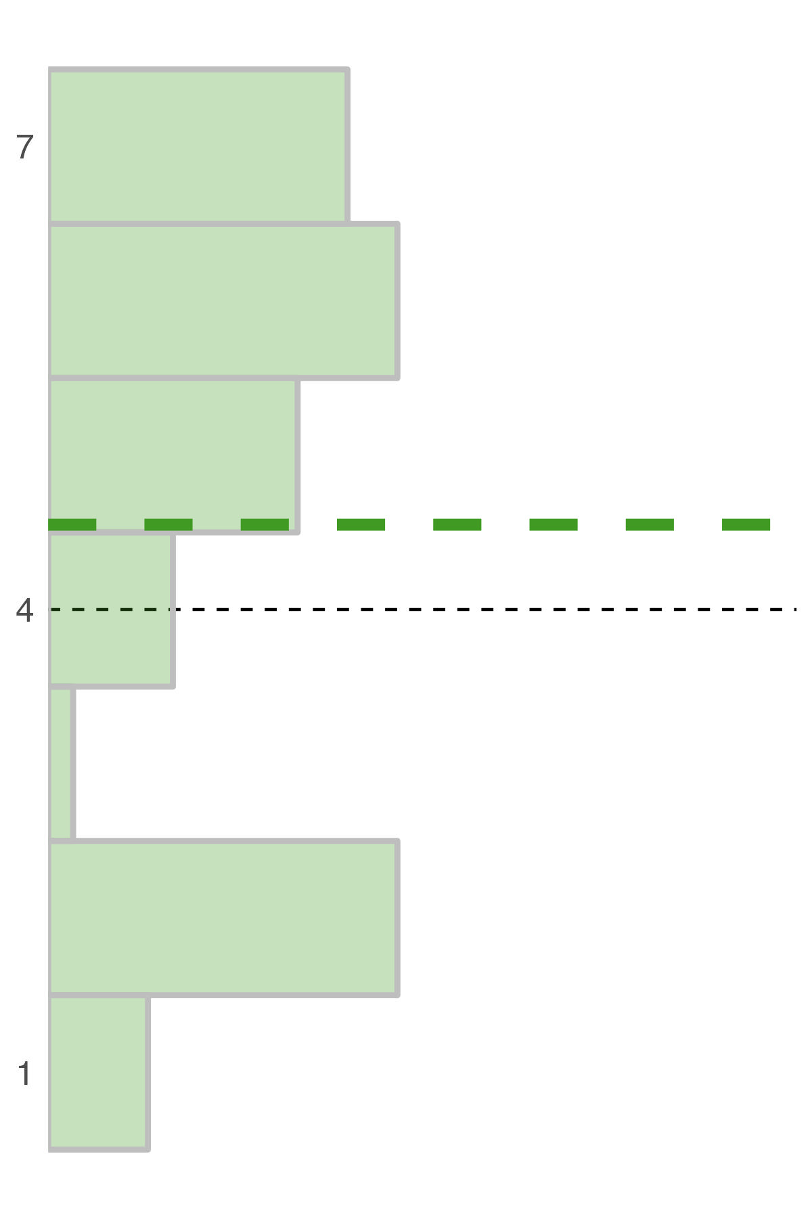

Slide 70
A fervent supporter visits the lab to applaud the scientists’ work.
A lab technician leaks footage of the scientists’ cruel acts.
A retired scientist returns to the lab to empty her desk.
A sleepy lab technician handles the equipment carelessly.

Slide 71
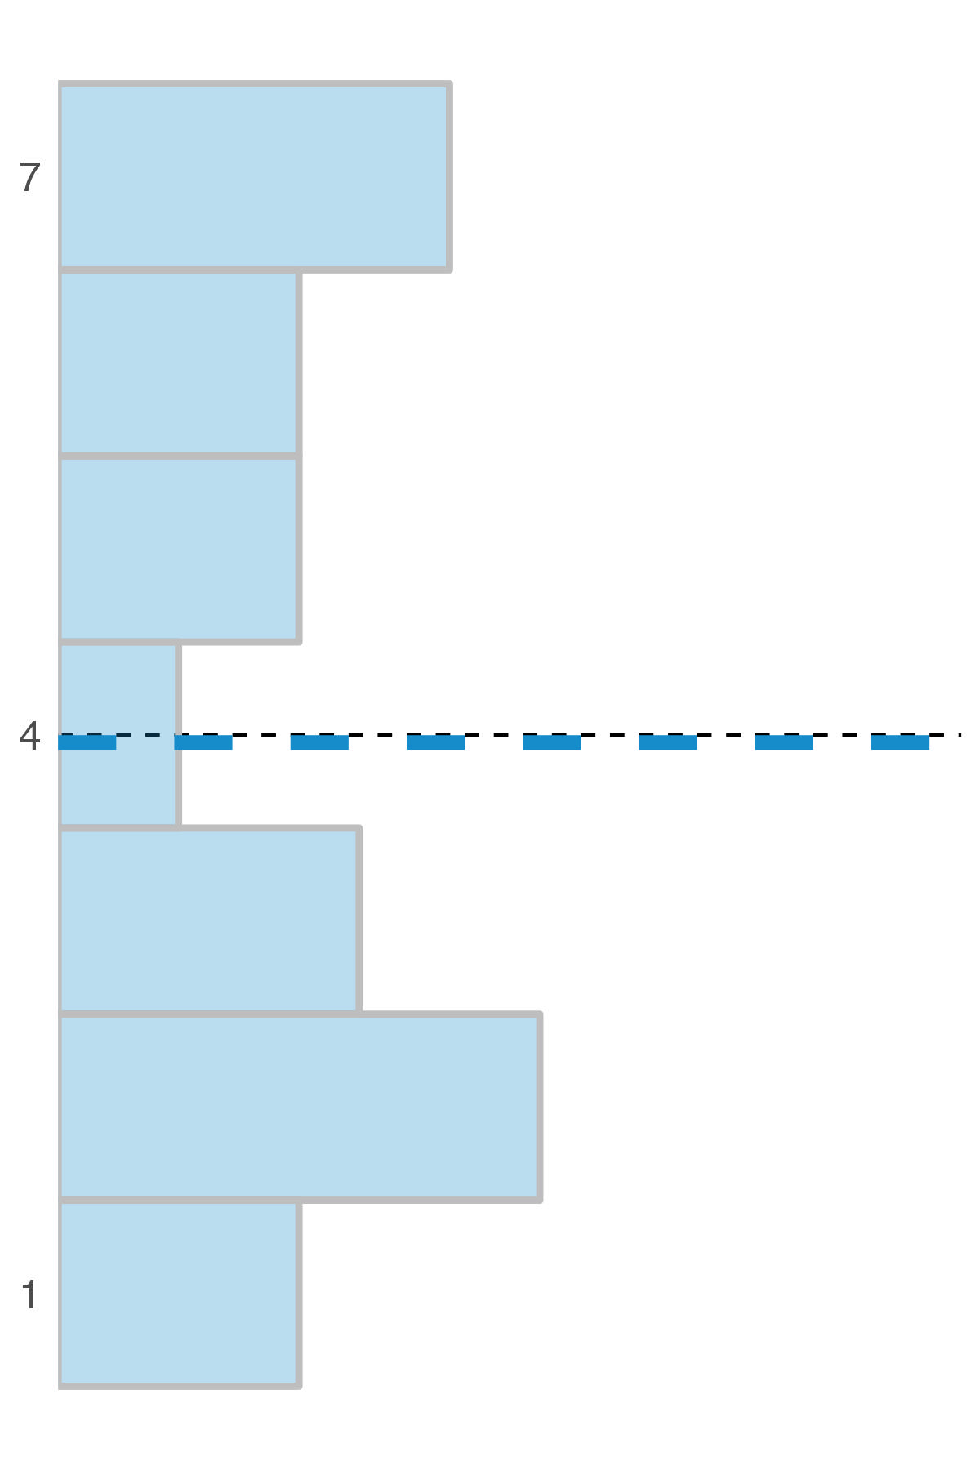
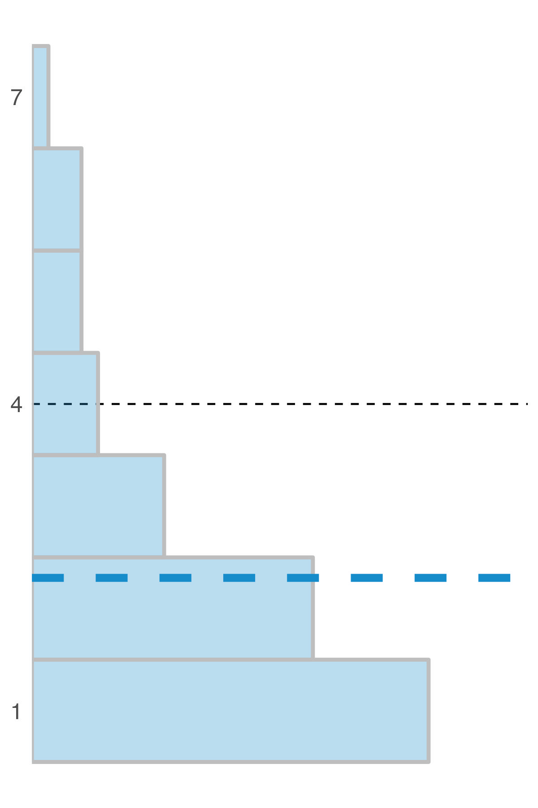

Slide 72
Purpose × Valence: F_{(1, 362)} = 29.38, p < .001
2 (valence: good vs. bad) × 2 (text: violate vs. comply) × 2 (purpose: violate vs. comply)

Slide 73
disagreement & conflict
Participant | Case1 | Case2 | Case3
1
2
3

Slide 74
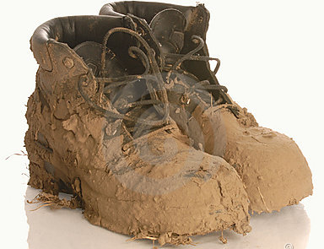
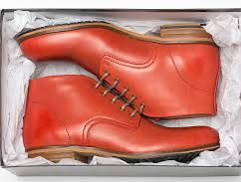
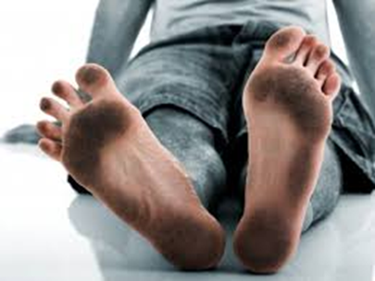
disagreement & conflict
👥 disagreement prediction
Participant | Case1 | Case2 | Case3
1 | T | T | T
2 | P | P | P
3 | T | T | T

Slide 75
disagreement & conflict
👤 conflict prediction
Participant | Case1 | Case2 | Case3
1 | P | T | T
2 | T | T | P
3 | T | P | T

Slide 76
by-participant regression
response = x * text + y * purpose + z

Slide 77
by-participant regression
response = x * text + y * purpose + z
x = 0 OR y = 0
x > 0 AND y > 0

Slide 78
by-participant regression
👥 disagreement 👤 conflict
convenience (n ~ 150) & nationally representative (n ~ 360) samples
20 - 40 observations per participant
Almeida et al., 2025, J Res Pers

Slide 79
by-participant regression
👥 disagreement 👤 conflict
Almeida et al., 2025, J Res Pers

Slide 80
by-participant regression
👥 disagreement 👤 conflict
60% (C) and 69% (NR) fit 👤 conflict
40% (C) and 31% (NR) fit 👥 disagreement
Almeida et al., 2025, J Res Pers

Slide 81
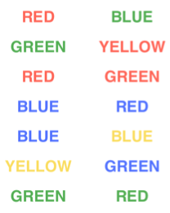
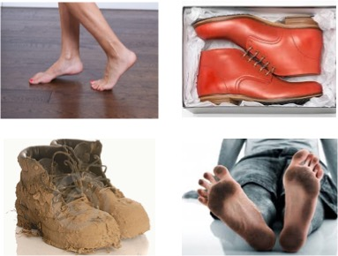
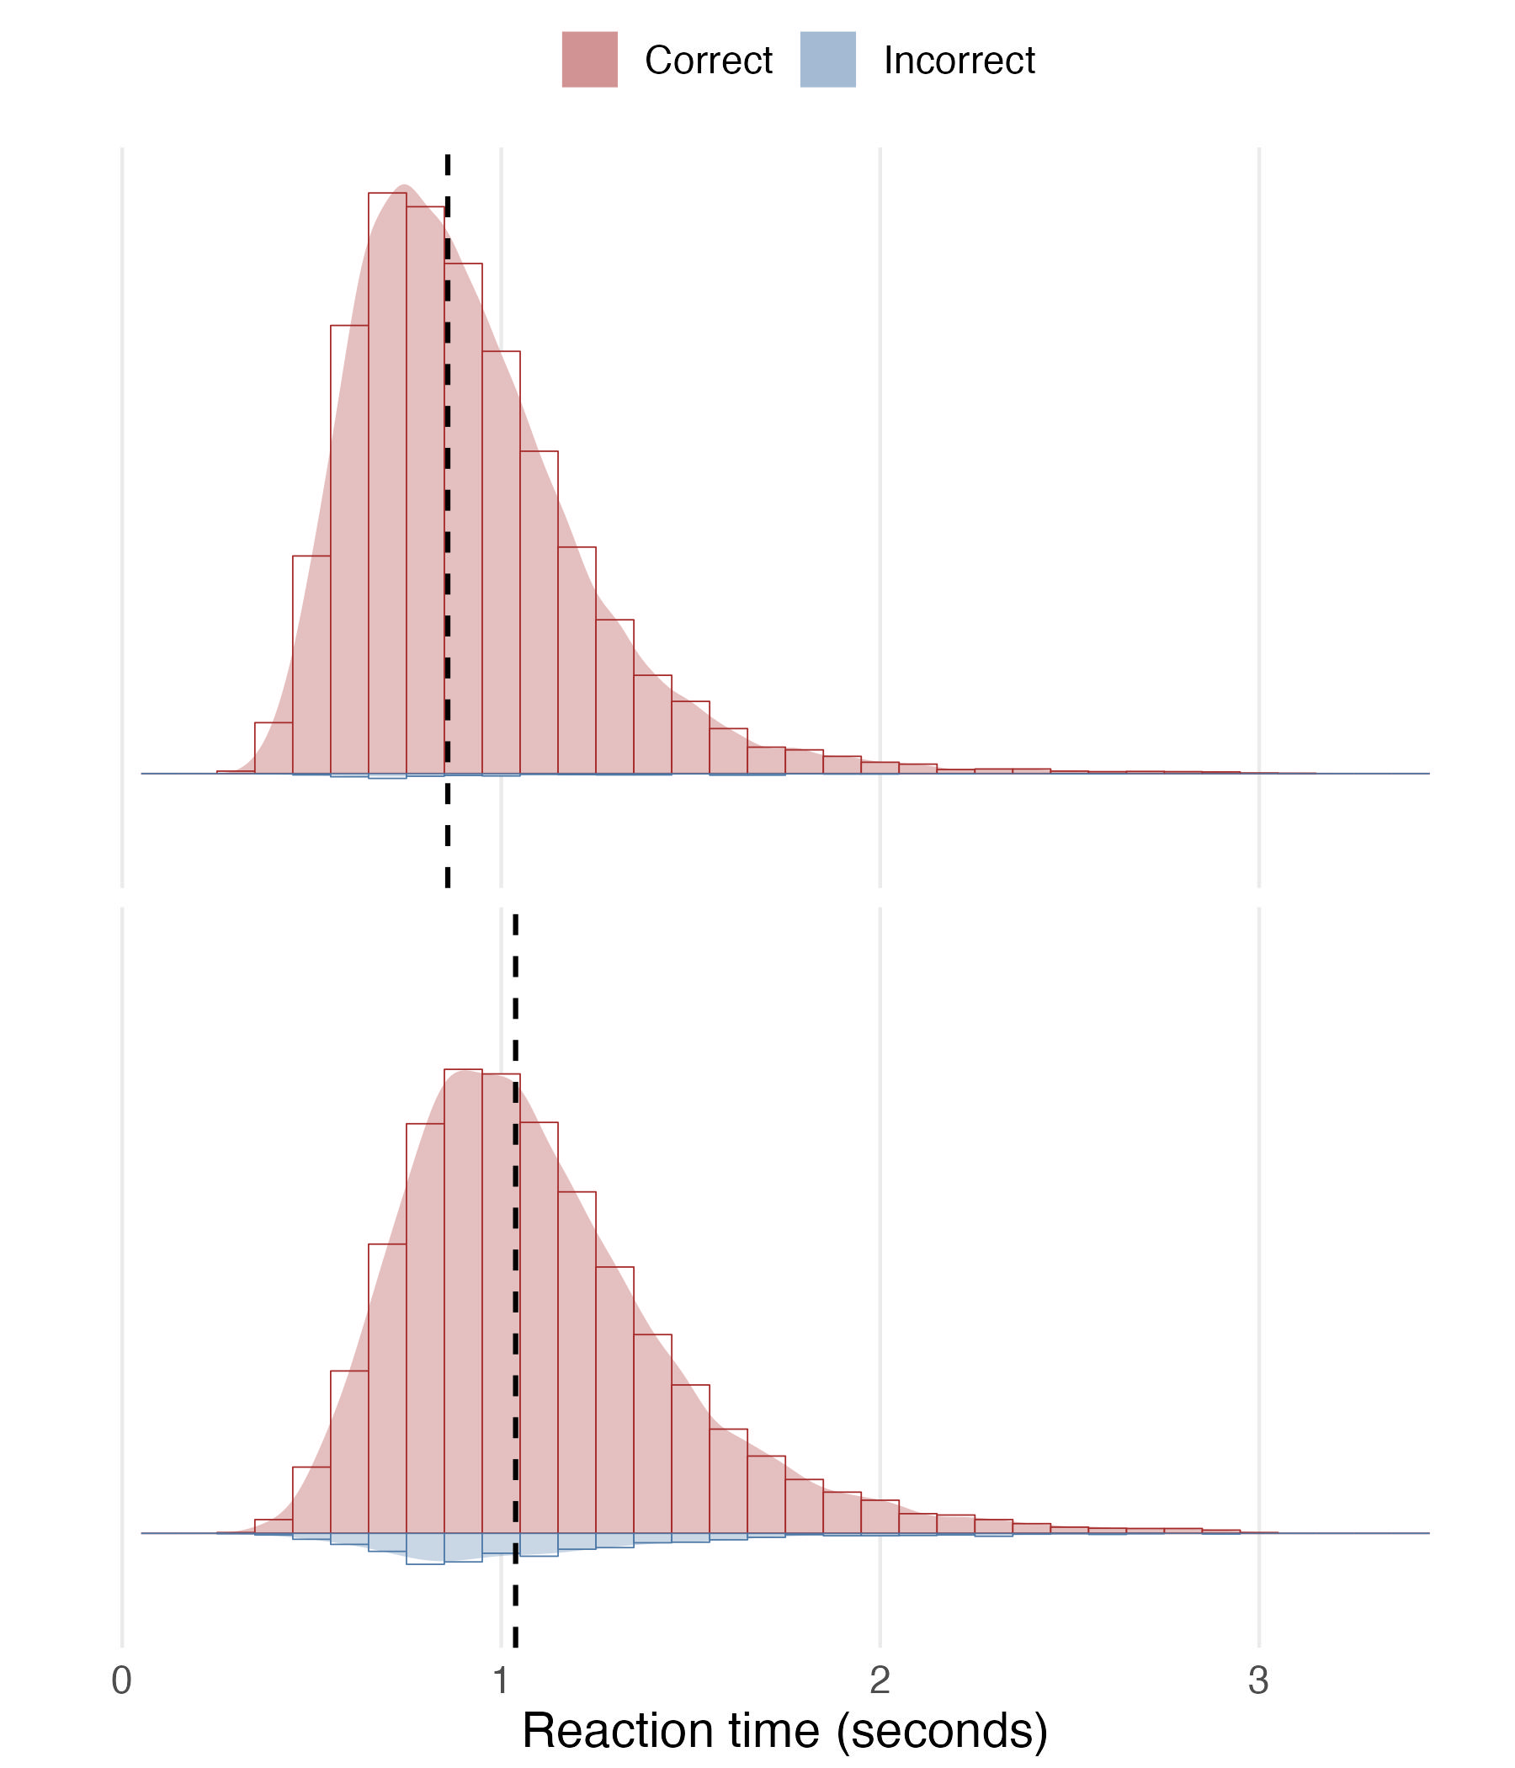
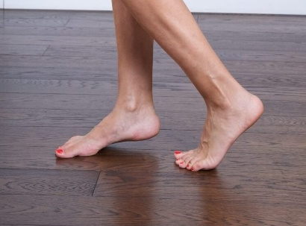
interference effects
> 99% accuracy
Mdn_{RT} = 859 ms
97% accuracy
Mdn_{RT} = 1038 ms
Engelmann et al., 2024 Proc Cog Sci Soc.

Slide 82
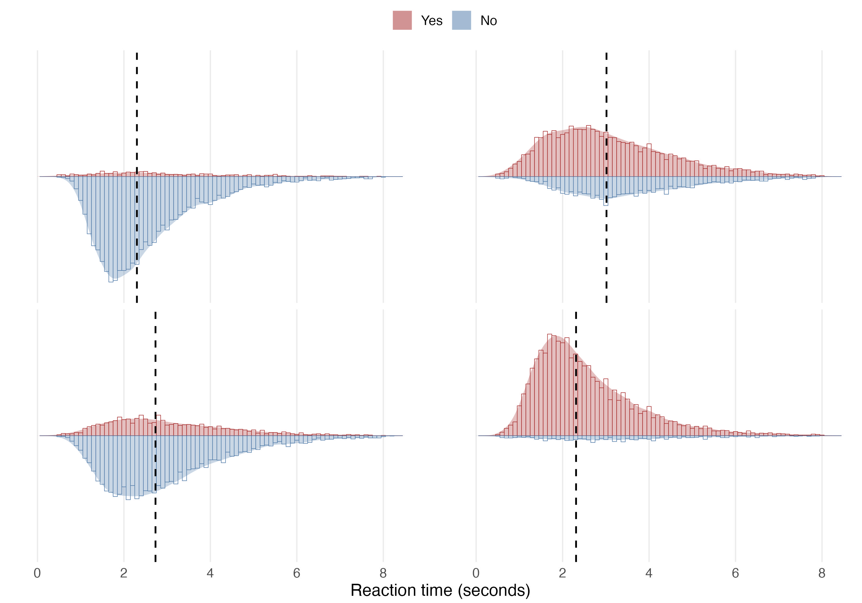
interference effects
95% No
Mdn_{RT} = 2300 ms
> 99% accuracy
Mdn_{RT} = 859 ms
97% accuracy
Mdn_{RT} = 1038 ms
93% Yes
Mdn_{RT} = 2311 ms

Slide 83
interference effects
95% No
Mdn_{RT} = 2300 ms
> 99% accuracy
Mdn_{RT} = 859 ms
69% Yes
Mdn_{RT} = 3015 ms
97% accuracy
Mdn_{RT} = 1038 ms
77% No
Mdn_{RT} = 2730 ms
93% Yes
Mdn_{RT} = 2311 ms

